Slide 1
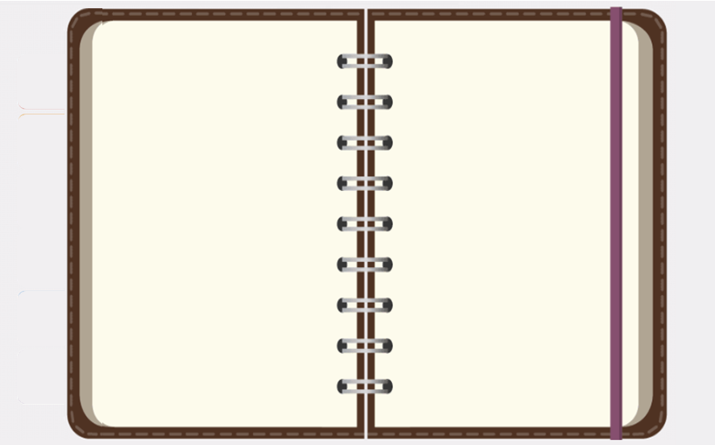
The E-Portfolio Navigation Buttons
Main Menu
<Left Click> on the icon to the immediate left to view my:
Artifacts & Evidences
<Left Click> on the icon to the immediate left to view my:
Resume and/or Curriculum Vitae
<Left Click> on the icon to the immediate left to view my:
Completed Courses
<Left Click> on the icon to the immediate left to view my:
About Me
Information
<Left Click> on the icon to the immediate left to view my:
Coursework Critical Reflections
<Left Click> on the icon to the immediate left to view my:
Exit this E-Portfolio At the Thank You Section

Slide 2
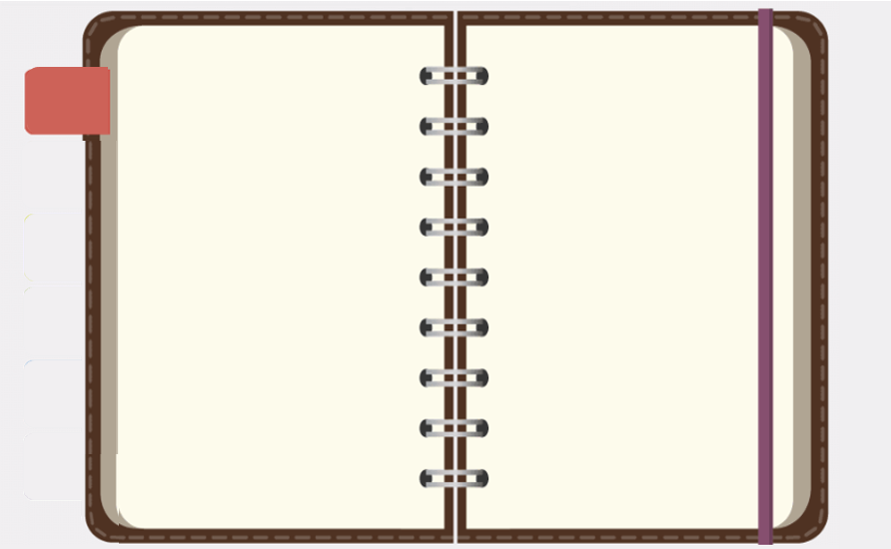
The E-Portfolio Navigation Buttons
Artifacts & Evidences

Slide 3
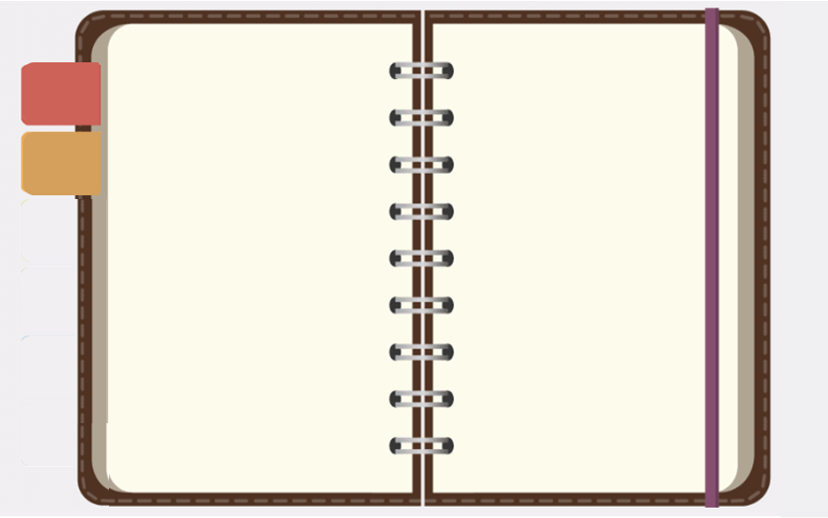
The E-Portfolio Navigation Buttons
Completed Courses

Slide 4
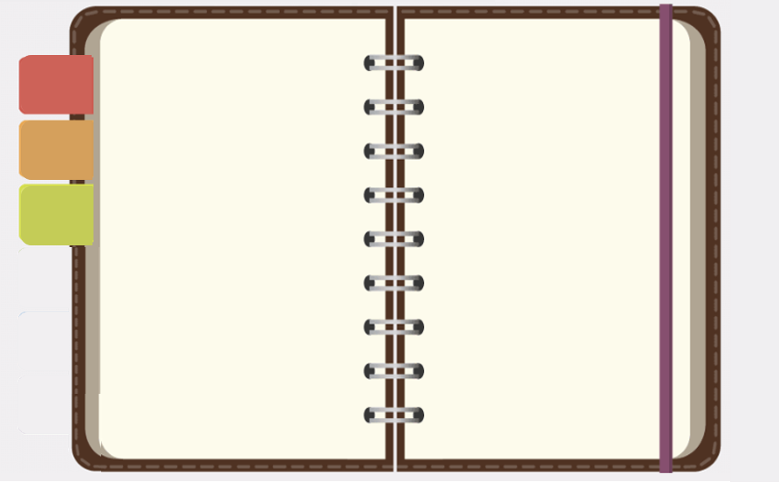
The E-Portfolio Navigation Buttons
Coursework Critical Reflection

Slide 5
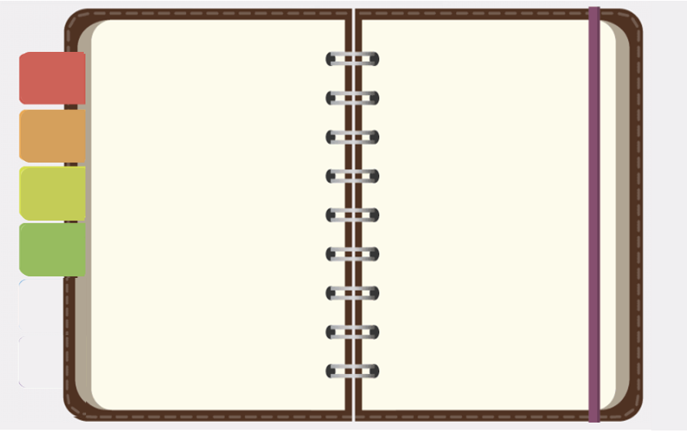
The E-Portfolio Navigation Buttons
Resume and/or Curriculum Vitae

Slide 6
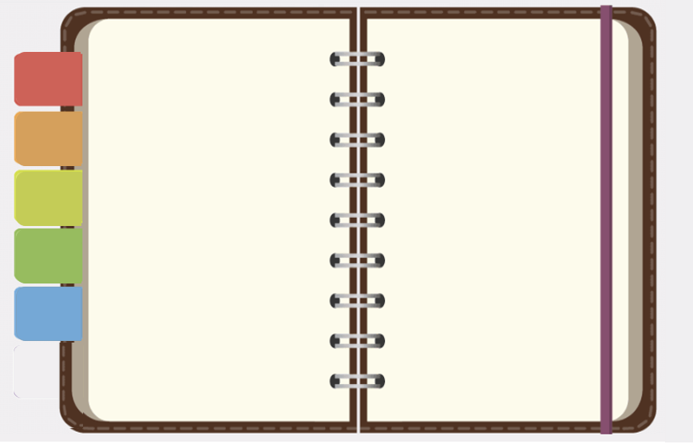
The E-Portfolio Navigation Buttons
About Me Information

Slide 7
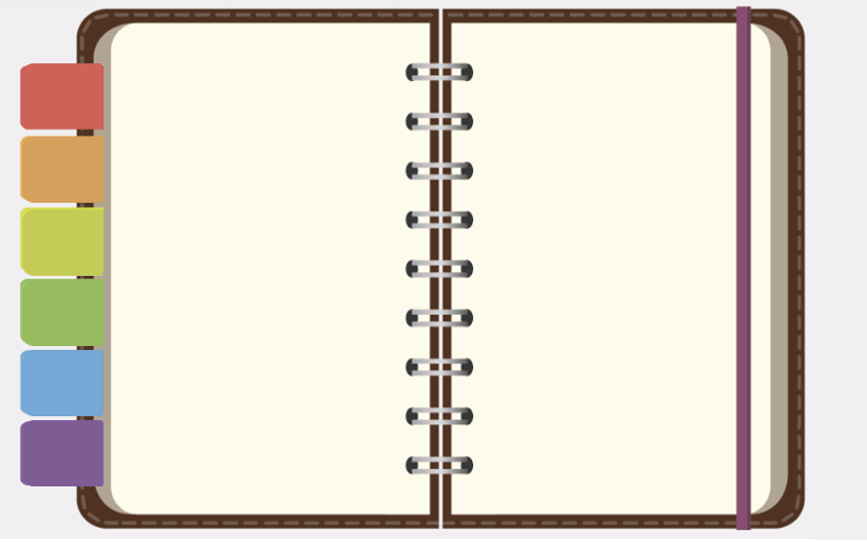
The E-Portfolio Navigation Buttons
Thank You!

